Slide 1

DESIGN PATTERNS
WAHYU ADITYA TAMA
Singleton Creational Pattern
Adapter Structural Pattern

Slide 2

Singleton design pattern
One global instance

Slide 3
What is it?
Single – ton
Only created once, used by all other classes
No public constructor. Private constructor + Getter method
Examples:
Database
Utility class (Calculator)

Slide 4
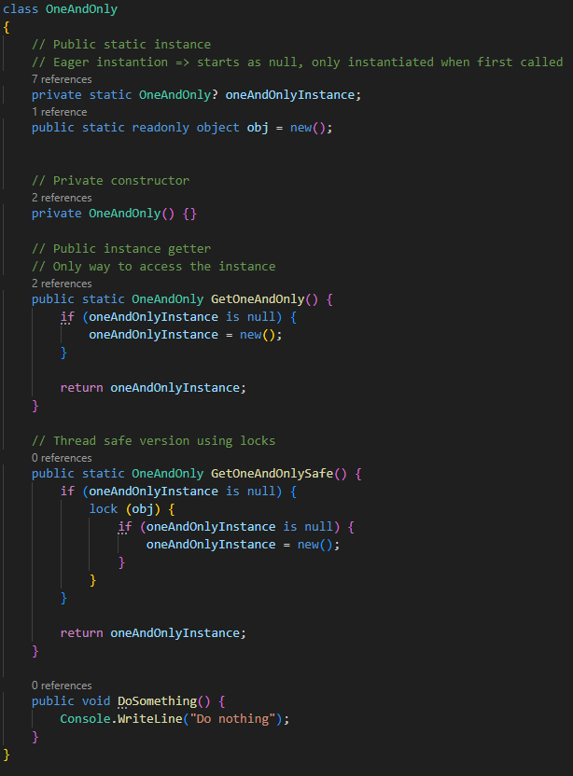
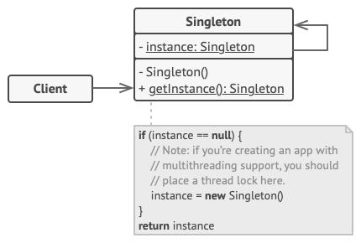
Sample class diagram

Slide 5
PROS
CONS
Only ever one instance
Only initialised when first requested. Saves memory
Single global access, easy to keep track and maintain
Difficult to unit test
Thread safe locking prevents parallel processing

Slide 6

adapter design pattern
Connecting incompatible classes

Slide 7
What is it?
Like electrical outlet adapter
Bridging incompatible systems
Example:
Library uses JSON but we use XML

Slide 8
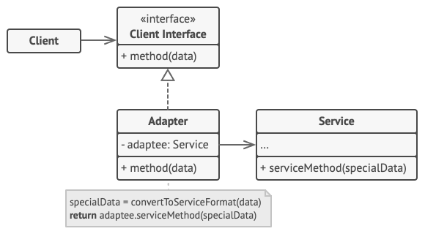
Sample class diagram

Slide 9
PROS
CONS
OCP Compliant
No need to change existing codebase
SRP Compliant
Data is data, service is service
Adapter task to bridge
Increase complexity
More incompatible service, more adapters to make

